Slide 1


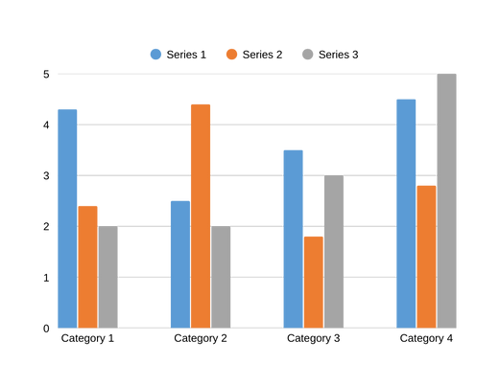
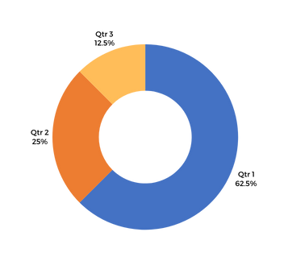

[Poster ID]
TITLE OF THE POSTER
[Authors name, Affiliation and Email]
R
e
C
o n
RESEARCH CONFERENCE
2025
Innovate | Include | Inspire
for a Sustainable Future
Introduction
  The poster has to be in A1 size (59.4 x 84.1 centimeters)
  Font in the main text should be more than 24.
  Heading and sub heading should be more than 40.
  You may follow multiple column or single column as per your convenience.
  Objectives
  A
  B
  C
  Methodology
  The system of methods and principles used for doing the work may represented using flow charts.
Major Findings
The information they get or come to as the result of the investigation or research represented by pictures and graphs
Discussions
The perfect interpretation of your results using graphs or diagrams
Conclusion
A conclusion is the final piece of writing in the research, essay, or article that summarizes the entire work. The conclusion should restate your work, summarize the key supporting ideas you discussed throughout the work, and offer your final impression on the central idea.
References
Minimum of three and maximum of five references.
Recommendations
A suggestion/s that something is suitable for a future purpose.
A
B
D
C
E
P
1
2
Q
R
3
National Institute of Technology Calicut

